Slide 1
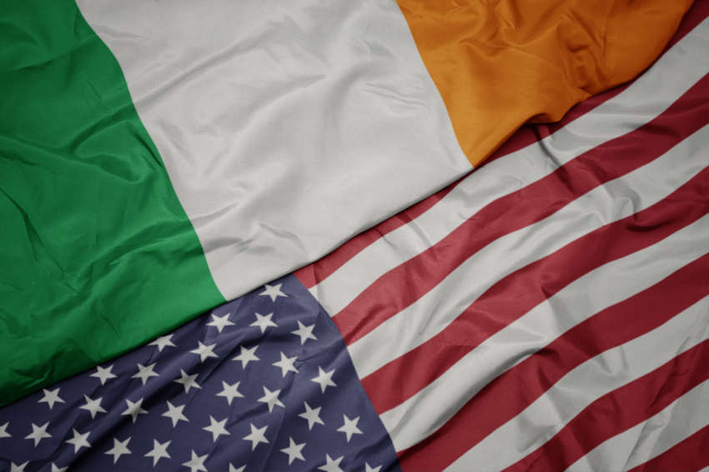






1960-1969
Chapter 28
LIFE IN THE 1960S
life in the 1960s
Strand Two & Three: The History of the World
@MsDoorley

Slide 2

1960-1969
Chapter 28
28.1: IRELAND IN THE 1960S
28.1: ireland in the 1960s
Strand Two & Three: The History of the World
@MsDoorley

Slide 3

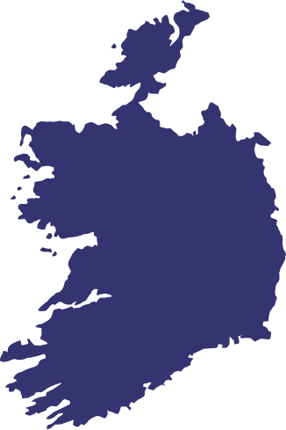
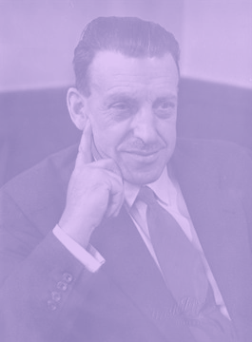




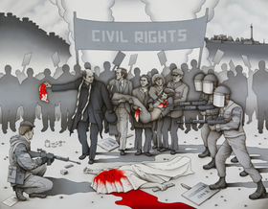

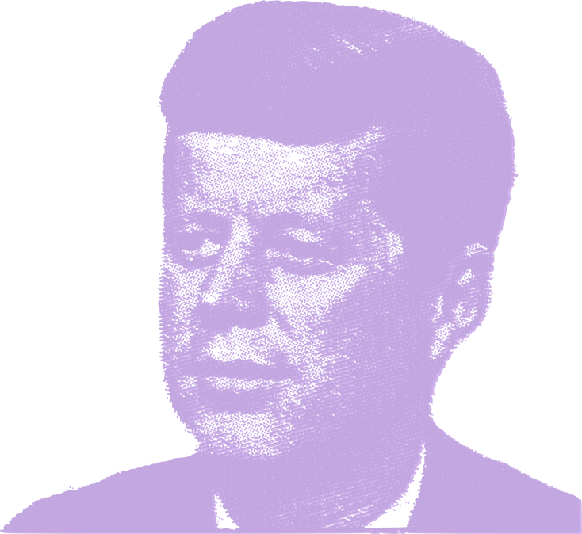





Chapter 28.1
IRELAND IN THE 1960S
Sean Lemass replaces Eamon de Valera as Taoiseach of Ireland
Donogh O'Malley introduces free education for the children of Ireland.
RTÉ is launched
1949
1959
1960
1961
1963
1966
1969
Strand Two & Three: The History of the World
Chapter Twenty-Eight: Life in the 1960s
The Republic of Ireland is established, completing full Irish independence from Britain.
Irish UN Peacekeeping Forces arrives in the Congo
John F Kennedy becomes the first President to visit Ireland in June. He is assassinated in the November of the same year.
The Troubles in Northern Ireland begin, lasting for almost two decades.
@MsDoorley

Slide 4
Learning Outcomes
•2.12 DEBATE the idea that the 1960s was an important decade on the island of Ireland, referring to relevant personalities, issues and events.
•3.11 EXPLORE the contribution of technological developments and innovation to historical change.
•3.13 DEBATE the idea that the 1960s was an important decade in Europe and the wider world, referring to relevant personalities, issues and events.
•1.2 CONSIDER contentious or controversial issues in history from more than one perspective and discuss the historical roots of a contentious or controversial issue or theme in the contemporary world.
•1.7 DEVELOP historical judgements based on evidence about personalities, issues and events in the past, showing awareness of historical significance.
Strand Two & Three: The History of the World
Chapter Twenty-Eight: Life in the 1960s
@MsDoorley

Slide 5
Introduction
The 1960s was a decade of huge change for Ireland and the rest of the world. In Ireland, the 1960s a period of; Political change, as one generation of leaders handed over to another; Economic change, as Ireland abandoned the policies of protectionism; and Social change, with the coming of RTÉ, Vatican II and free education. It was the decade when the modern Irish state was born.
Strand Two & Three: The History of the World
Chapter Twenty-Eight: Life in the 1960s
@MsDoorley

Slide 6
1960-1969
Chapter 28
28.1.1 THE 1950S: IRELAND’S LOST DECADE
28.1.1 the 1950s: ireland’s lost decade
Strand Two & Three: The History of the World
@MsDoorley

Slide 7
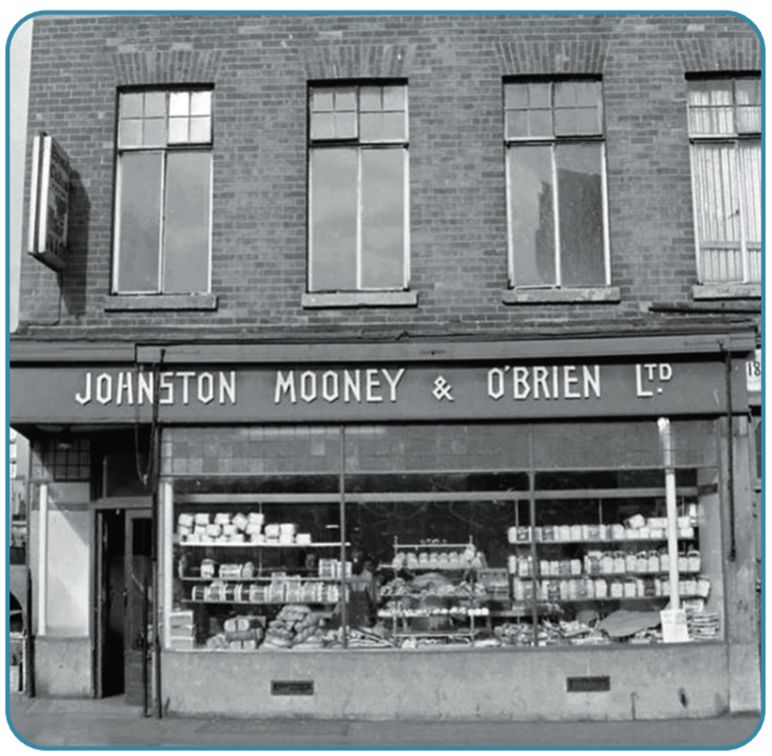
Economic crisis
Following World War II, Ireland faced many problems. Governments since the 1930s had followed protectionism (policy of placing high tariffs (charges) on goods coming into Ireland to protect Irish businesses from foreign competition), resulting in very expensive imported goods. This made Irish business quite inefficient and badly run. There was little money available to invest in the economy. Combined, these things created high unemployment.
Strand Two & Three: The History of the World
Chapter Twenty-Eight: Life in the 1960s
Diagram taken from Artefact, 2nd Edition by Eimear Jenkinson and Gregg O'Neill (educate.ie)
@MsDoorley

Slide 8
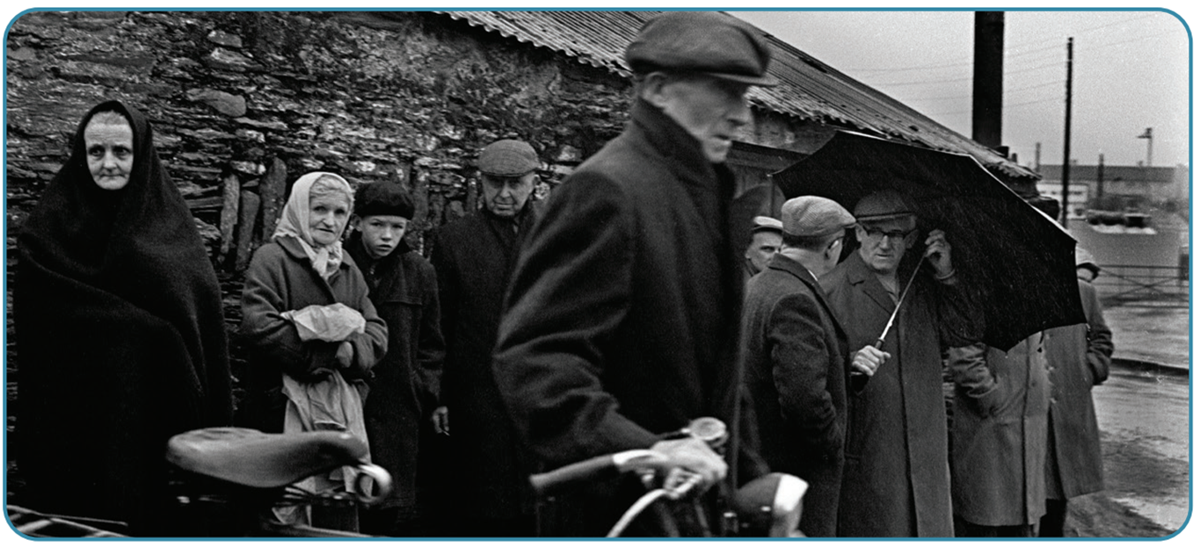
Social problems
As there were very few jobs available in Ireland, people were forced to emigrate from Ireland in large numbers – 44,000 per year in the 1950s. By 1961, the population had fallen to its lowest levels since the Great Famine. This led to rural depopulation, where young people left rural areas to find work and increasingly only older people remained.
Strand Two & Three: The History of the World
Chapter Twenty-Eight: Life in the 1960s
Diagram taken from Artefact, 2nd Edition by Eimear Jenkinson and Gregg O'Neill (educate.ie)
@MsDoorley

Slide 9
Political instability
Ireland in the 1950s was still being led by men such as Éamon deValera and Richard Mulcahy, who had fought in the War of Independence and the Irish Civil War 30 years before, who continued to follow old ideas and ways of doing things. This problem was made worse by a series of weak governments in the late 1940s into the 1950s, with elections held in 1948, 1951 and 1954. After each election, a weak government of either Fianna Fáil or a coalition of parties were formed, meaning no majority existed in the Dáil, leaving the government unable to tackle the problems Ireland faced.
Strand Two & Three: The History of the World
Chapter Twenty-Eight: Life in the 1960s
@MsDoorley

Slide 10
Checkpoint pg. 261 (Artefact, 2nd Edition)
  What is protectionism and what impact did it have on Ireland?
  Give two examples of the political problems Ireland face in the 1950s.
  How many people were leaving Ireland every year in the 1950s?
Strand Two & Three: The History of the World
Chapter Twenty-Eight: Life in the 1960s
@MsDoorley

Slide 11
1960-1969
Chapter 28
28.1.2 CHANGES IN POLITICS AND THE ECONOMY
28.1.2 changes in politics and the economy
Strand Two & Three: The History of the World
@MsDoorley

Slide 12
1960-1969
Chapter 28
SEÁN LEMASS, 1899-1971
Seán Lemass, 1899-1971
Strand Two & Three: The History of the World
@MsDoorley

Slide 13
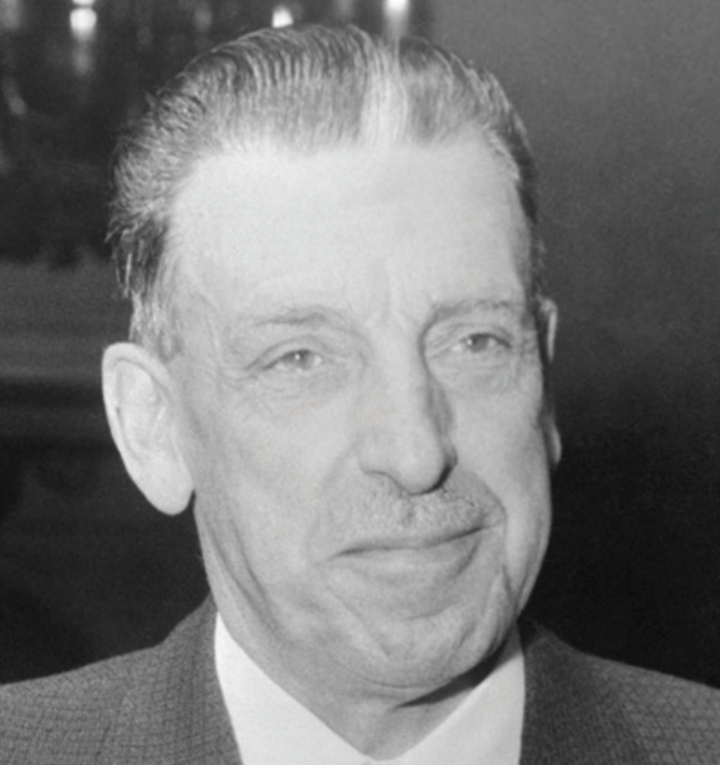
Early life and career
Seán Lemass was born in Dublin in 1899. He fought in the 1916 Rising and the War of Independence. He was one of the founding members of Fianna Fáil in 1926. He served as Minister for Industry and Commerce and as Minister for Supplies during World War II. He became Taoiseach and leader of Fianna Fáil in 1959 after de Valera retired.
Strand Two & Three: The History of the World
Chapter Twenty-Eight: Life in the 1960s
Diagram taken from Artefact, 2nd Edition by Eimear Jenkinson and Gregg O'Neill (educate.ie)
@MsDoorley

Slide 14
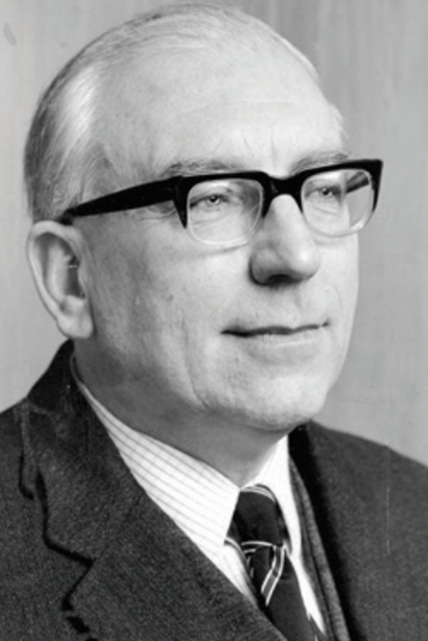
First Programme for Economic Expansion
Lemass was convinced that radical changes in economic policy were needed to save the country. He worked with the Secretary-General of the Department of Finance, T.K. Whitaker, to produced and implement the First Programme for Economic Expansion in 1959. Its main aims were:
  Free Trade: Ireland would reduce tariffs on imports to encourage trade and reduce prices.
  Encourage foreign investment: taxes were reduced on foreign companies that set up in Ireland and were given grants to create jobs.
  Grants to business and farmers: £220 million was given to help them modernise so they could increase production and be more efficient.
The programme was a huge success. The economy grew at 4% per year during the 1960s – double its target. Unemployment had fallen by a third by 1961. Emigration fell from 44,000 a year to 16,000 a year in 1961 and to 11,000 a year by 1971.
Strand Two & Three: The History of the World
Chapter Twenty-Eight: Life in the 1960s
Diagram taken from Artefact, 2nd Edition by Eimear Jenkinson and Gregg O'Neill (educate.ie)
@MsDoorley

Slide 15
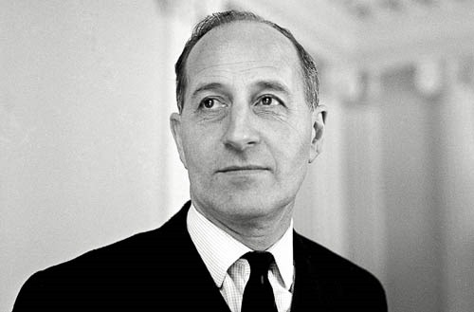
New relationship with Northern Ireland
Since partition in 1921, the governments in Belfast and Dublin had little contact; Lemass was determined to change this. While he continued to want a united Ireland, he thought the two parts of the island should be ‘good neighbours’. In January 1965, he travelled to Belfast and met the Northern Irish Prime Minister, Terence O’Neill, who visited Dublin too. They agreed to cooperate on non-controversial matters such as tourism, education and agriculture. Trade increased between the two parts of the island.
Strand Two & Three: The History of the World
Chapter Twenty-Eight: Life in the 1960s
Diagram taken from Artefact, 2nd Edition by Eimear Jenkinson and Gregg O'Neill (educate.ie)
@MsDoorley

Slide 16
Opening Ireland to the world
Under Lemass’ leadership, Ireland began to engage with the world much more. Ireland had joined the United Nations in 1955 but became more active in the 1960s and was even election to the UN Security Council (its highest body) in 1962. Irish soldiers served in UN peacekeeping missions in the Congo, Cyprus and the Middle East.
In 1961, Ireland applied to join the European Economic Community (EEC), along with Britain. Lemass decided to do this because Britain was Ireland’s biggest export market and he hoped to gain new markets for Irish goods in Europe and grow the economy. When France stopped the British application (they worried that the British were too close to the US), Ireland withdrew its application; Ireland and Britain would eventually join the EEC in 1973.
Ireland’s openness to the world was marked in June 1963, when the US President John F. Kennedy (the first Catholic President of the US) became the first foreign head of state to visit. His visit drew the international spotlight and let Ireland show how much it had changed in recent years.
Strand Two & Three: The History of the World
Chapter Twenty-Eight: Life in the 1960s
Diagram taken from Artefact, 2nd Edition by Eimear Jenkinson and Gregg O'Neill (educate.ie)
@MsDoorley

Slide 17
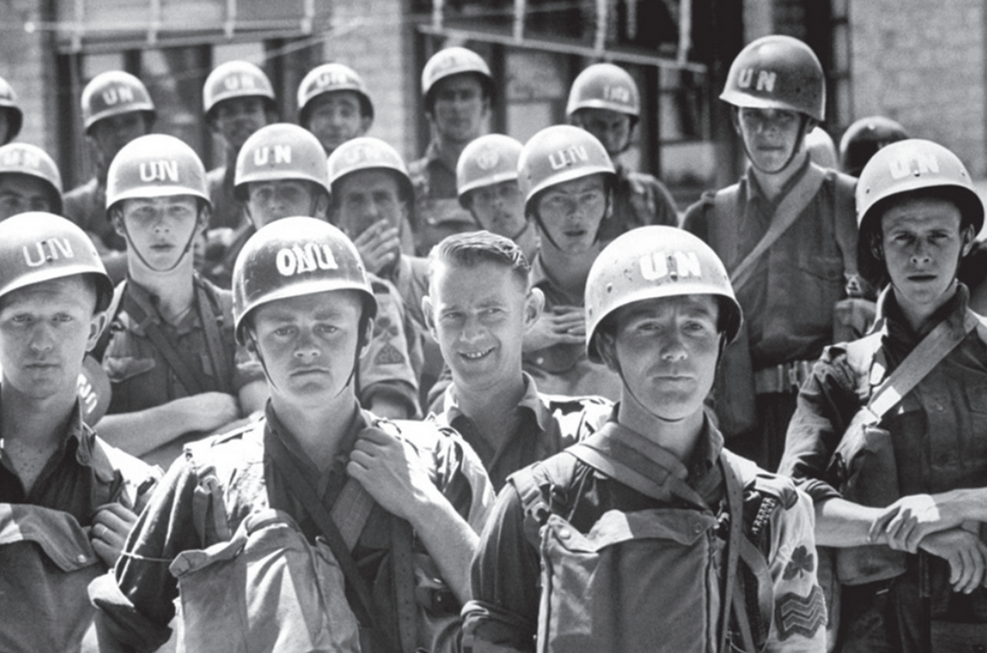
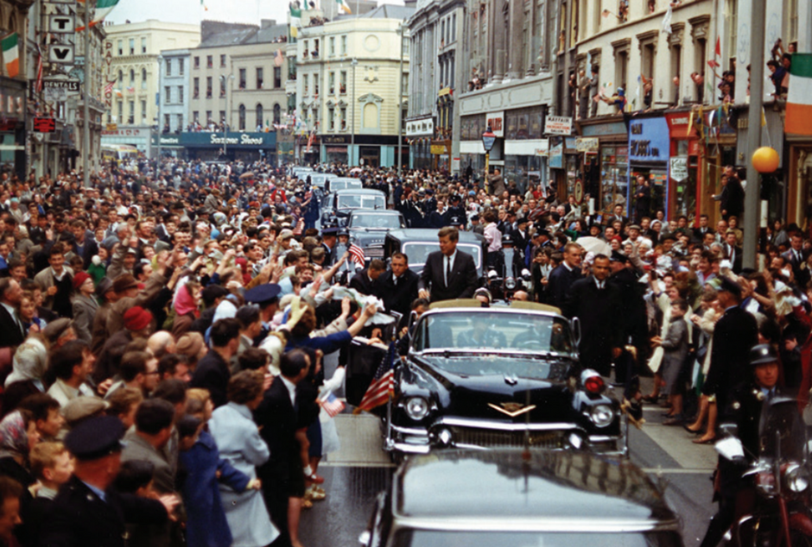
Did You Know?
President Kennedy often told his family how much he had enjoyed his visit to Ireland. When he was assassinated in November 1963, his wife Jacqueline requested that Irish army cadets be part of the burial service.
Strand Two & Three: The History of the World
Chapter Twenty-Eight: Life in the 1960s
Diagram taken from Artefact, 2nd Edition by Eimear Jenkinson and Gregg O'Neill (educate.ie)
@MsDoorley

Slide 18
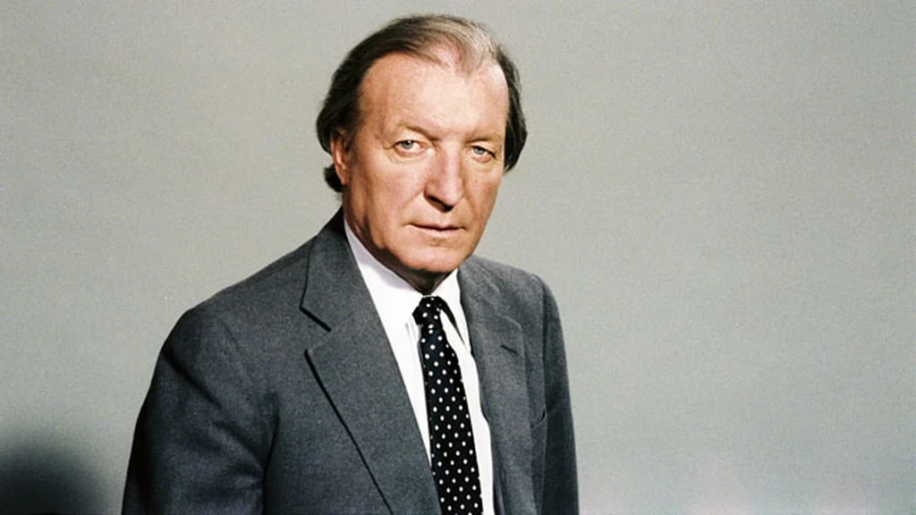
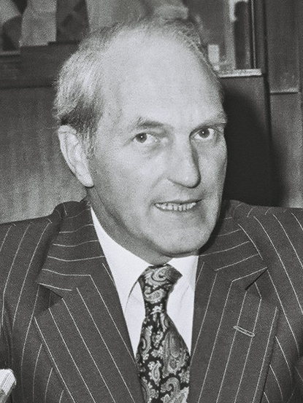
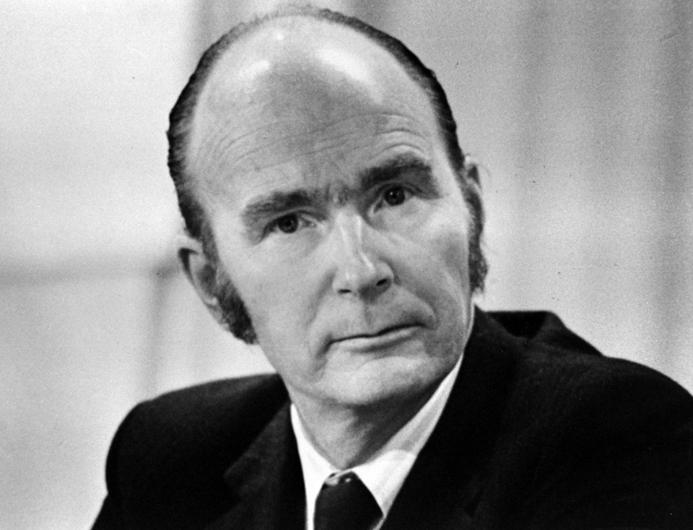
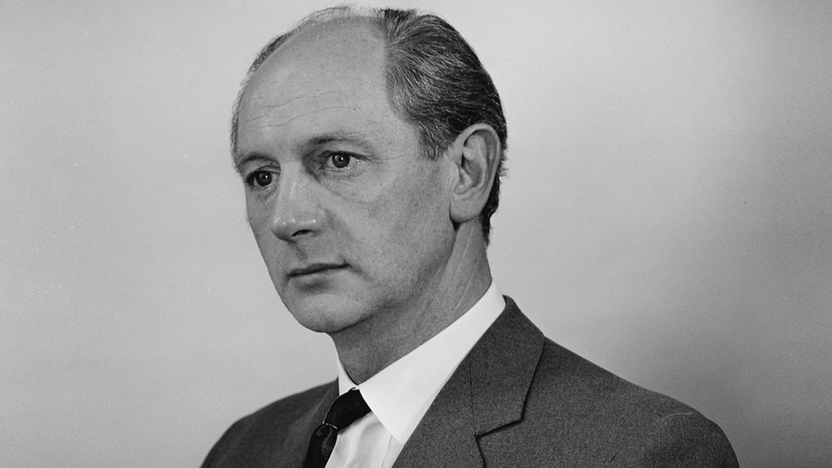
Leadership change
Lemass led Fianna Fáil to victory in the 1961 and 1965 general elections. He appointed young TDs like Charles Haughey, George Colley and Patrick Hillary as government officials; they would come to dominate Irish politics for the next 30 years. He presided over the 1966 50th Anniversary celebrations of the Easter Rising. Saying it was a time for a new generation to take over, Lemass resigned at the end of 1966. He was succeeded by Jack Lynch, who, at 49, was the first Taoiseach of the generation to have grown up in an independent Ireland. Lemass died five years later, in 1971, at the age of 72.
Strand Two & Three: The History of the World
Chapter Twenty-Eight: Life in the 1960s
Diagram taken from Artefact, 2nd Edition by Eimear Jenkinson and Gregg O'Neill (educate.ie)
@MsDoorley

Slide 19
Checkpoint pg. 263 (Artefact, 2nd Edition)
  What were the main points of the First Programme for Economic Expansion?
  Was it a success? Give reasons for your answer.
  How did Lemass change relations with Northern Ireland?
  In what way did Ireland become active in the United Nations?
  Why did Ireland apply to join the EEC in 1961 and was this application successful?
  Who succeeded Lemass as Taoiseach?
Strand Two & Three: The History of the World
Chapter Twenty-Eight: Life in the 1960s
@MsDoorley

Slide 20
1960-1969
Chapter 28
28.1.3 SOCIAL CHANGE IN THE 1960S
28.1.3 social change in the 1960s
Strand Two & Three: The History of the World
@MsDoorley

Slide 21
RTÉ
Until the 1960s, Ireland had no domestic television service; another example of Ireland lagging behind the rest of the world. In 1960, the government passed the Broadcasting Authority Act, which set up an independent authority to run radio and television in Ireland. Telefis Eireann (later RTÉ) launched on 31st December 1961. By the 1970s, more than 50% of the homes in the country had a TV set and most received only the one RTE channel. Television was key in changing Irish society over the following decades. It did so through:
  Foreign influence: People saw shows from the US and the UK along side news from around the world. They could compare their lives to other people’s and ask why Ireland was different.
  Debating controversial topics: Programmes like the Late Late Show, under Gay Byrne, regularly discussed topics like marriage breakdown, women’s rights, religion, sex, homosexuality and the Traveller Community; over time, it would help to shift society’s attitudes towards these topics.
  Challenging the powerful: On RTÉ, people saw political leaders, senior Catholic bishops and other important people in authority being openly challenged for the first time and having to defend their actions and answer questions.
Strand Two & Three: The History of the World
Chapter Twenty-Eight: Life in the 1960s
@MsDoorley

Slide 22
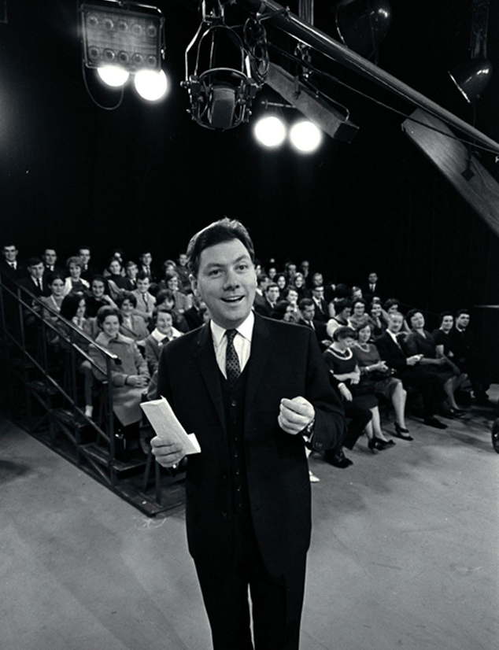
Gay Byrne, 1934-2019
Gay Byrne was born in Rialto, Dublin. After secondary school, he worked in a cinema and then as a clerk for an insurance company. In 1958 he began his career in broadcasting with a fifteen-minute radio show. He moved to Britain to work with the BBC and returned to Ireland when Teilifís Éireann was launched in 1961. In 1962, he made his first appearance as host of The Late Late Show, which he continued to host until 1999. He had a unique interviewing style and was able to connect with the studio audience. The Late Late Show dealt with controversial topics for the time. Byrne's interviews introduced viewers to unfamiliar personal situations and to issues that would not have been openly discussed, including marriage breakdown, domestic violence, contraception, women's rights, religion, sex, homosexuality, Mother and Baby homes and more. Over time, this helped to foster greater open-mindedness in Irish society.
In 1972 Gay Byrne was given his own morning show on RTÉ radio called The Gay Byrne Show, which aired until 1998. In 2007 the Irish Film and Television Awards gave a Lifetime Achievement Award. Byrne continued to be involved in entertainment and broadcasting until late in his life. He died in 2019, aged 85.
Strand Two & Three: The History of the World
Chapter Twenty-Eight: Life in the 1960s
Diagram taken from Artefact, 2nd Edition by Eimear Jenkinson and Gregg O'Neill (educate.ie)
@MsDoorley

Slide 23
The Catholic Church
In 1962, Pope John XXIII called the Second Vatican Council to reform the Catholic Church and make it better suited for the modern world. Vatican II, as it became known, was made up of senior Catholic clergy from around the world who made radical changes to the Church:
  The Mass was to be said in the vernacular (native language) instead of Latin, and the priest would face the congregation.
  Laypeople (non-priests) were given a greater role in the Church.
  The Bible was to be published in the vernacular, people were encouraged to read it themselves and all of the Church teachings were to come from the Bible.
  Ecumenism sought more understanding between the various different Christian Churches around the world. (Yes, these were some of the changes Luther had made when he split from the Catholic Church 400 years before)
After Vatican II, more people began to question the teachings and authority of the Church. This would begin the gradual lessening of its influence on Irish society.
Strand Two & Three: The History of the World
Chapter Twenty-Eight: Life in the 1960s
@MsDoorley

Slide 24
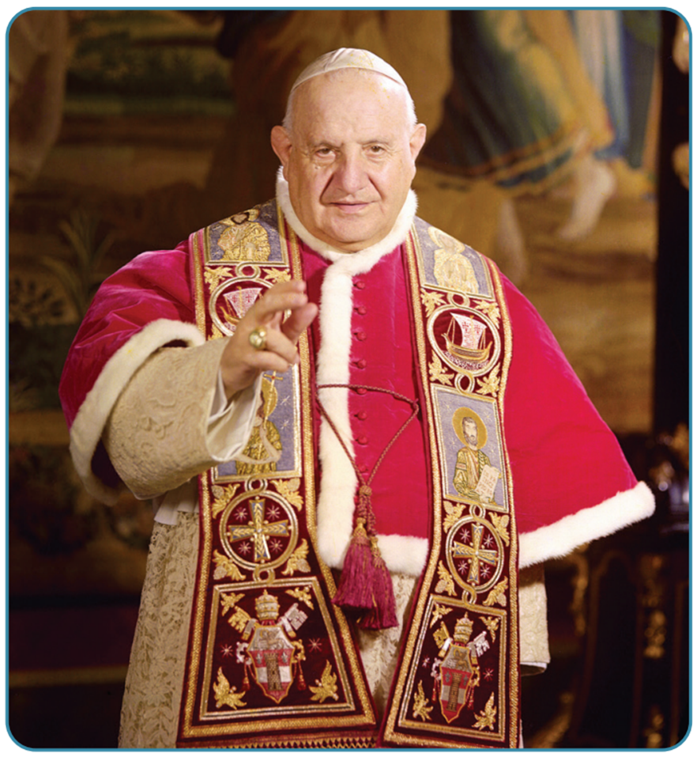
Strand Two & Three: The History of the World
Chapter Twenty-Eight: Life in the 1960s
Diagram taken from Artefact, 2nd Edition by Eimear Jenkinson and Gregg O'Neill (educate.ie)
@MsDoorley

Slide 25
Education
In 1966, the Minister for Education, Donogh O’Malley, wanted to expand the educated workforce so that Ireland would be more attractive to foreign businesses. He introduced major reforms to the education system, including:
  Free schooling up to the Intermediate Certificate (the old name for the Junior Cycle) - state would pay teacher wages which they continue to do.
  Free transport for students to school.
  Grants to build more schools.
  Regional Technical Colleges (the old name for Institutes of Technology/Technological Universities such as Technological University of the Shannon - the Athlone Institute of Technology).
The impact of these reforms was huge: the numbers sitting the Leaving Certificate rose from 8,600 in 1961 to 24,000 in 1972. For reference, a new record of students sat both state exams in June 2023; 63,000 at Leaving Cert and 71,000 at Junior Cycle. The practice of Irish children leaving education after primary school was ended by the early 1970s.
Strand Two & Three: The History of the World
Chapter Twenty-Eight: Life in the 1960s
@MsDoorley

Slide 26
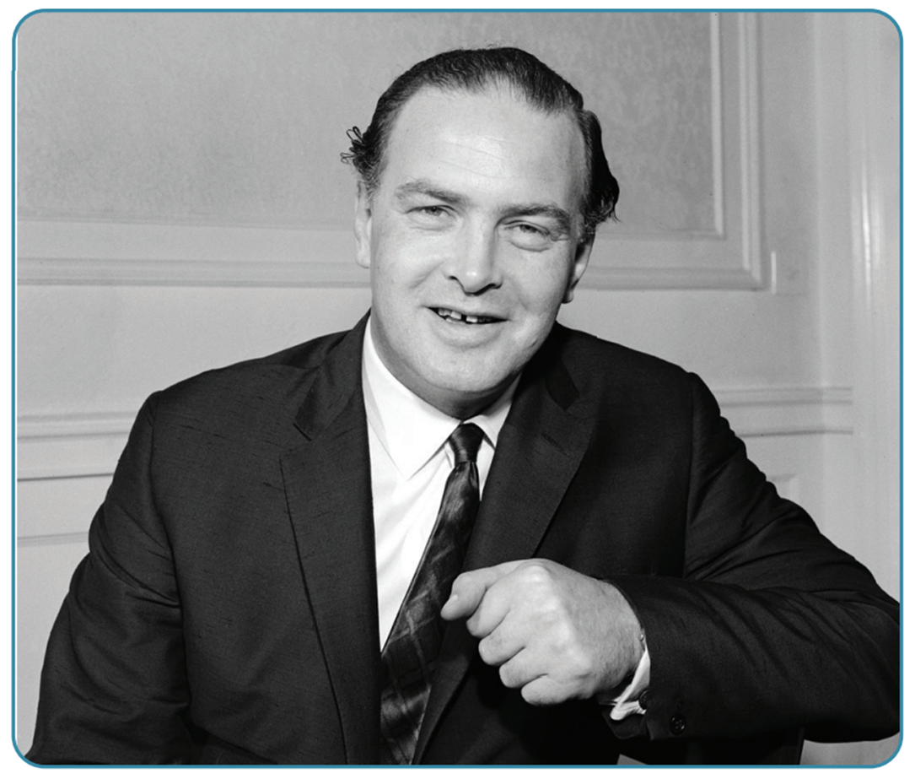
Strand Two & Three: The History of the World
Chapter Twenty-Eight: Life in the 1960s
Diagram taken from Artefact, 2nd Edition by Eimear Jenkinson and Gregg O'Neill (educate.ie)
@MsDoorley

Slide 27
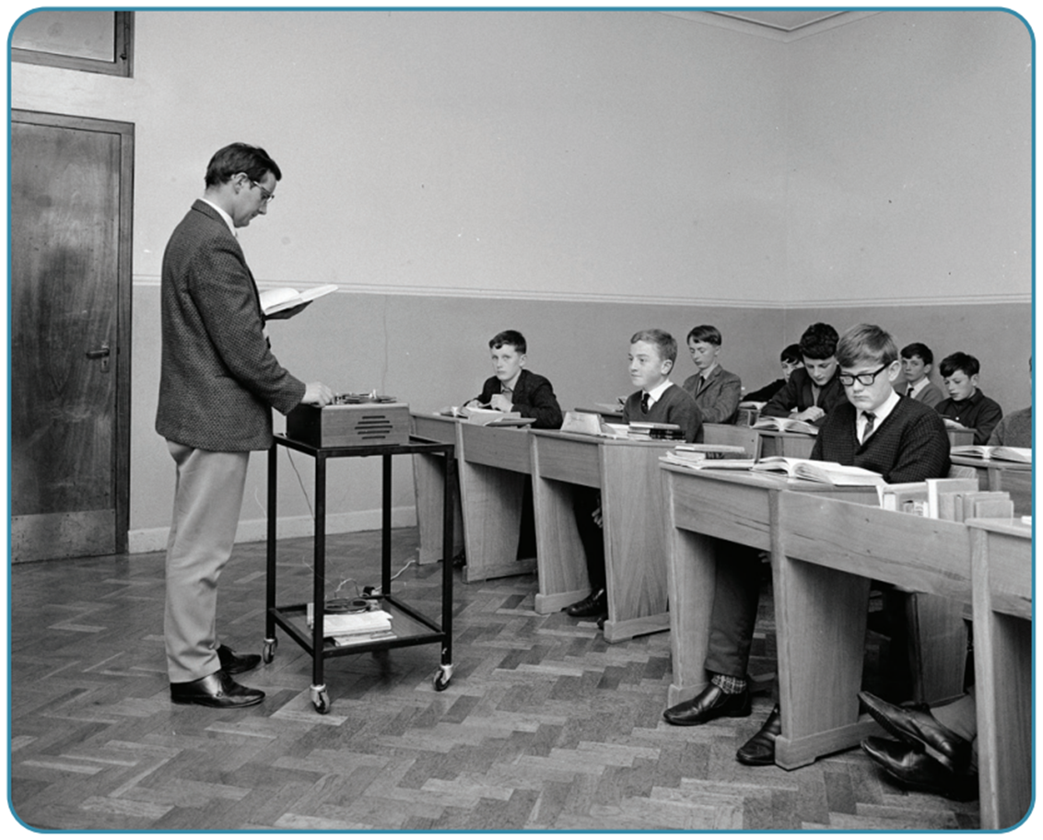
Strand Two & Three: The History of the World
Chapter Twenty-Eight: Life in the 1960s
Diagram taken from Artefact, 2nd Edition by Eimear Jenkinson and Gregg O'Neill (educate.ie)
@MsDoorley

Slide 28
Checkpoint pg. 266 (Artefact, 2nd Edition)
  When did RTÉ start broadcasting?
  Name two ways in which RTÉ affected Irish Society.
  Why did Pope John XXIII call the Second Vatican Council?
  Name two reforms of the Catholic Church introduced by the Second Vatican Council.
  How did Donogh O’Malley reform Irish education in 1966?
  Which do you think was the most important change in Irish society; RTÉ, Vatican II or the education reforms? Give reasons for your answers.
Strand Two & Three: The History of the World
Chapter Twenty-Eight: Life in the 1960s
@MsDoorley

Slide 29

1960-1969
Chapter 28
THE US AND THE WIDER WORLD IN THE 1960S
the us and the wider world in the 1960s
Strand Two & Three: The History of the World
@MsDoorley

Slide 30
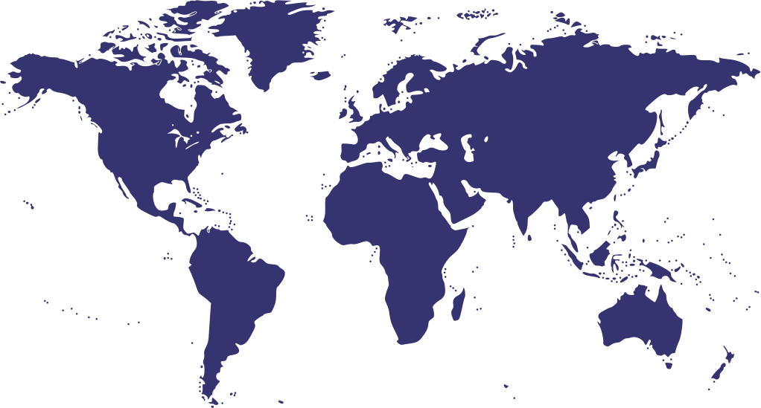
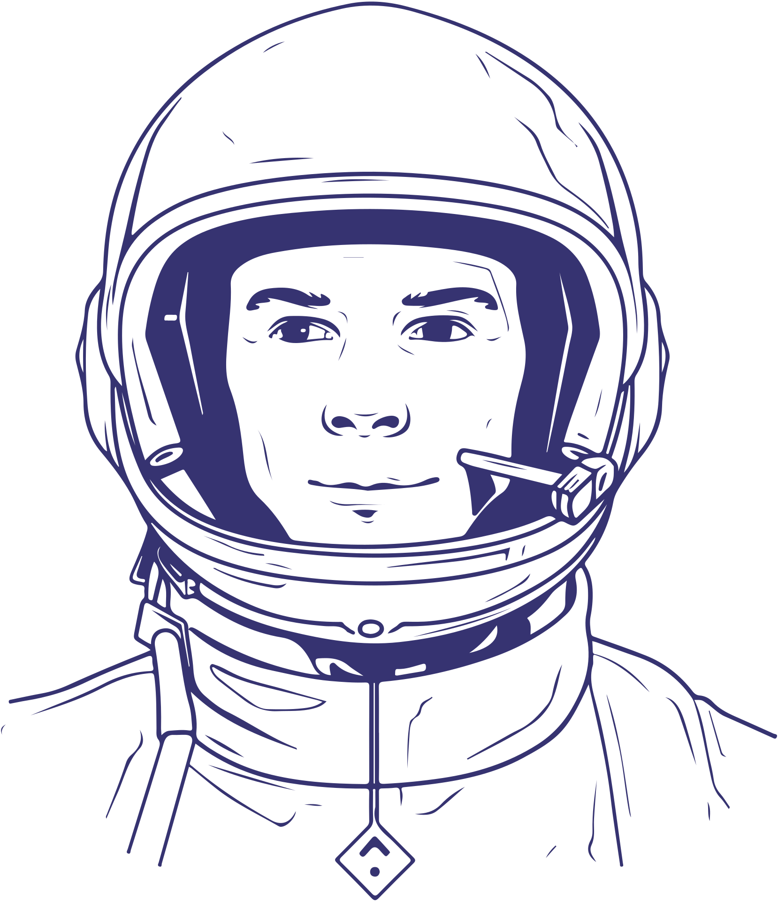
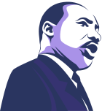
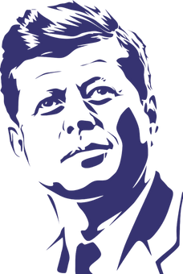



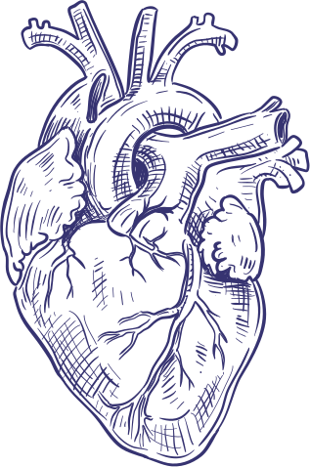
THE WORLD IN THE 1960S
Yuri Gagarin becomes the first man into space
John F Kennedy is assassinated in Houston, Texas.
Martin Luther King Jr is assassinated in Memphis, Tennessee
1960
1961
Aug 1963
Nov 1963
1967
1968
1969
Strand Two & Three: The History of the World
Chapter Twenty-Eight: Life in the 1960s
Most African countries gain their independence.
Martin Luther King Jr gives his famous 'I Have a Dream' speech.
The first heart transplant takes place in South Africa.
Neil Armstrong becomes the first man to walk on the moon
@MsDoorley

Slide 31
Introduction
The 1960s was a decade of profound change in the world. As we have seen in other chapters, it was a decade of rising tensions between the Superpowers almost plunged the world in World War II. Europe moved closer together with the foundations of the modern-day European Union. The transformation of the Republic of Ireland while violence was breaking out in Northern Ireland. We walked on the moon. People around the world took to the streets to demand their equal rights. Youth culture was born.
Strand Two & Three: The History of the World
Chapter Twenty-Eight: Life in the 1960s
@MsDoorley

Slide 32
1960-1969
Chapter 28
28.2.1: TECHNOLOGICAL CHANGE - THE SPACE RACE
28.2.1: technological change - the space race
Strand Two & Three: The History of the World
@MsDoorley

Slide 33
Introduction
Both superpowers spent huge sums of money on scientific research, hoping to develop new weapons to ensure their side won any war between them; the US, for example, were spending $344 billion (€303 billion) on defence by 1960. As we saw during our study of the Cold War, this arms race led to the development of more powerful nuclear weapons as well as more deadly aircraft, tanks and naval vessels. Some reasons why both superpowers spent heavily on ‘the space race’ were:
  Rockets: the rockets designed to carry satellites and then men into space could be used to carry nuclear bombs to attack the other side.
  Rivalry: by being the first superpower to achieve great feats in technology, they would ‘prove’ the superiority of their system over their opponent’s; space travel was the most spectacular example of this.
  Technology: new technology developed during the space race (such as computers) could be used in other areas of both military and civilian life.
Strand Two & Three: The History of the World
Chapter Twenty-Eight: Life in the 1960s
@MsDoorley

Slide 34
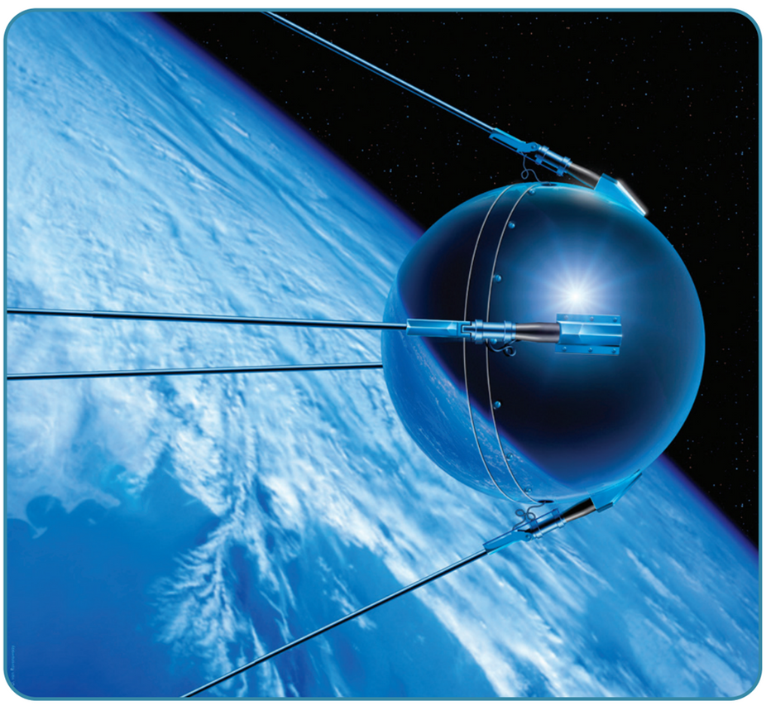
The first satellites
The Soviets achieved considerable early success. They launched the world’s first satellite, Sputnik, on 4th October 1957. It was able to transmit a faint radio signal back to Earth. Their success came as a huge surprise, especially in the US. The US became concerned that the Soviets had moved ahead, and that there was now a ‘missile gap’ between them, especially when the first US satellite, the Vanguard, exploded on the launchpad in December 1957. The US eventually launched the Explorer satellite on 1st February 1958.
Strand Two & Three: The History of the World
Chapter Twenty-Eight: Life in the 1960s
Diagram taken from Artefact, 2nd Edition by Eimear Jenkinson and Gregg O'Neill (educate.ie)
@MsDoorley

Slide 35
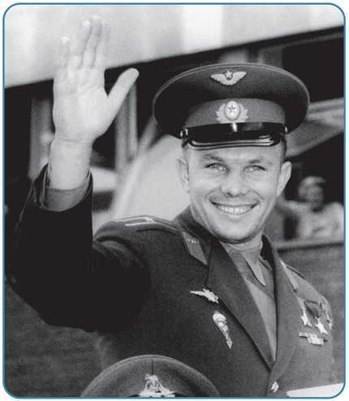
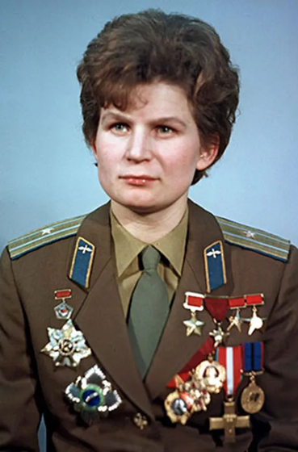
The first people in space
The superpowers now competed to see who could get the first man into space. On 12th April 1961, Yuri Gagarin orbited Earth and landed safely on his return. This was seen as a huge success for the Soviets; Gagarin toured the world which the Soviets used as a prominent propaganda piece. The Soviets scored another success when Valentina Tereshkova became the first woman in space in June 1963. The US finally managed to send a man into orbit in February 1962 when John Glenn piloted the Friendship 7. As the US had been beaten in the early goals of the space race, US President John F. Kennedy was determined that they should succeed at the final, hardest, goal: landing a man on the moon. JFK was so annoyed about the Soviet’s success that he banned Gagarin from visiting the US. In May 1961, Kennedy told the US Congress that their aim should be ‘before this decade is out, of landing a man on the moon and returning him safely to the Earth’.
Strand Two & Three: The History of the World
Chapter Twenty-Eight: Life in the 1960s
Diagram taken from Artefact, 2nd Edition by Eimear Jenkinson and Gregg O'Neill (educate.ie)
@MsDoorley

Slide 36
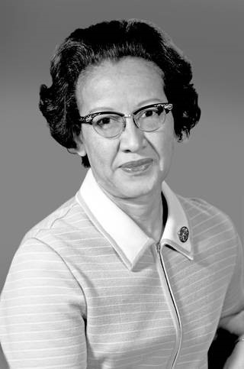
Katherine Johnson, 1918-2020
Katherine Johnson was born Creola Katherine Coleman in West Virginia, USA. She had an extraordinary aptitude for mathemathics, draduating from high school aged 14 and college aged 18. As an African-American woman, however, she faced both racist and sexist discrimination. Having graduated as one of the first three black students to attend West Virginia University, she went to work in the all-black West Area Computing unit at NASA. In 1958, she became part of the Space Task Group. By 1962, she had become so trusted by the astronauts that John Glenn asked for her specifically to check computer calculations for his flight on the Friendship 7, the USA's first manned orbit. In 1969, she helped to chart the course for the Apollo 11 flight to the Moon. Johnson was awarded many accolades during her life, including the Presidential Medal of Freedom in 2015 by President Obama. She died in 2020 at the age of 101 and her story is told in the 2016 film, Hidden Figures.
Strand Two & Three: The History of the World
Chapter Twenty-Eight: Life in the 1960s
Diagram taken from Artefact, 2nd Edition by Eimear Jenkinson and Gregg O'Neill (educate.ie)
@MsDoorley

Slide 37
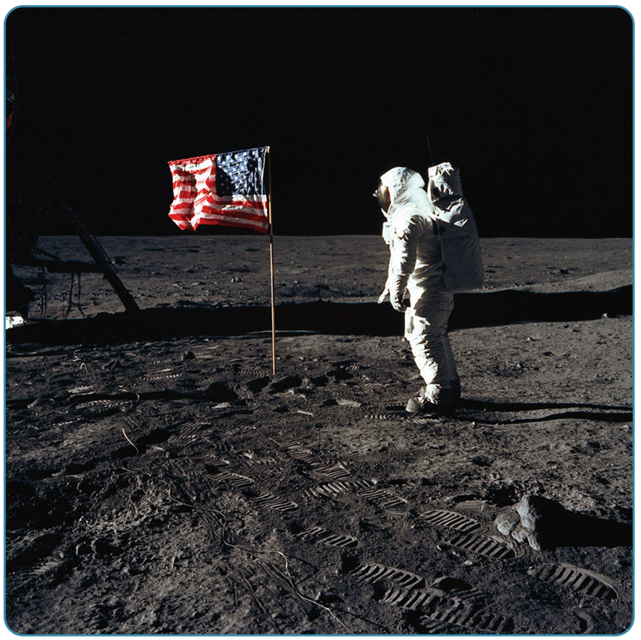
The Moon Landings
In response to Kennedy’s challenge, the National Aeronautics and Space Administration (NASA) launched the Gemini and Apollo missions to develop the required technology to reach, land and return from the moon. NASA built the Saturn V Rocket to carry the Apollo spacecraft out of Earth’s orbit, towards the moon. Apollo 11 launched from Kennedy Space Centre in Florida on 16th July 1969 with astronauts Neil Armstrong, Edwin ‘Buzz’ Aldrin and Michael Collins on board.
Three days later, they reached the moon and orbited it seven times. On 20th July 1969, Armstrong and Aldrin landed the lunar module, the Eagle, on the moon’s surface. A camera in the Eagle provided live coverage as Armstrong stepped out of the craft and uttered the famous words: ‘That’s one small step for man, one giant leap for mankind’. Over 500 million people around the world made this the most watched event in television history up to that point. After conducting some experiments and collecting samples, the astronauts successfully returned to Earth.
Strand Two & Three: The History of the World
Chapter Twenty-Eight: Life in the 1960s
Diagram taken from Artefact, 2nd Edition by Eimear Jenkinson and Gregg O'Neill (educate.ie)
@MsDoorley

Slide 38
Results of the moon landings
•By landing men on the moon, the US clearly ‘won’ the space race. This gave them a huge propaganda victory.
•Five more Apollo missions would land on the moon, but over time, the lunar landings lost public support due to their cost and NASA ended them in 1972.
•Satellite, communication and computer technologies advanced greatly as a result of technological breakthroughs arising from the space race. This paved the way for the revolution in satellite communications and computers in the 1970s and 1980s.
Strand Two & Three: The History of the World
Chapter Twenty-Eight: Life in the 1960s
@MsDoorley

Slide 39
Checkpoint pg. 377 (Artefact, 2nd Edition)
  Why did the superpowers compete in space during the Cold War?
  What was the first satellite in space?
  Who was the first man in space?
  Why did President Kennedy commit the US to landing a man on the moon?
  Who was the first man on the moon?
  Why was the moon landing seen as a huge triumph for the US?
  What were the results of the moon landings?
Strand Two & Three: The History of the World
Chapter Twenty-Eight: Life in the 1960s
@MsDoorley

Slide 40
Checkpoint pg. 377 (Artefact, 2nd Edition)
  So that they could ‘prove’ the superiority of their political system over their opponent’s by developing the best technology.
  Sputnik, in 1957.
  Yuri Gagarin.
  8 years.
  Neil Armstrong.
  The USA had succeeded at the final, hardest goal of the space race; it was a huge propaganda victory.
  Aside from the propaganda victory of having been the first country to put a man on the moon, five more Apollo missions went to the moon, and there were significant advances in satellite and communications technology.
Strand Two & Three: The History of the World
Chapter Twenty-Eight: Life in the 1960s
@MsDoorley

Slide 41
1960-1969
Chapter 28
28.2.2: THE DECADE OF PROTEST
28.2.2: the decade of protest
Strand Two & Three: The History of the World
@MsDoorley

Slide 42
The Struggle for African American Rights
In the 1860s, the US had fought a civil war over the issue of slavery; despite its abolition, African-Americans were still treated as second-class citizens for much of the next century. They were discriminated against in many states in education, housing, public facilities, employment, policing, the court system and voting.
By the 1950s, African-Americans were no longer willing to accept their treatment and began the Civil Rights Movement to fight for equal rights. The Civil Rights Movement came under the leadership of Baptist preacher, Dr Martin Luther King Jr, who called for strictly non-violent protest (the use of protest marches and boycotts of businesses, using media to highlight discrimination and attacking discrimination laws in the courts). The protesters were often harassed, attacked, beaten and arrested for participating.
The use of boycott and its name has an Irish origin – it was popularised by Charles Stewart Parnell during the Irish Land War (1880) when he had his tenant followers stop buying or using anything from Charles Cunningham Boycott when he refused to reduce the tenants’ rents.
Strand Two & Three: The History of the World
Chapter Twenty-Eight: Life in the 1960s
@MsDoorley

Slide 43
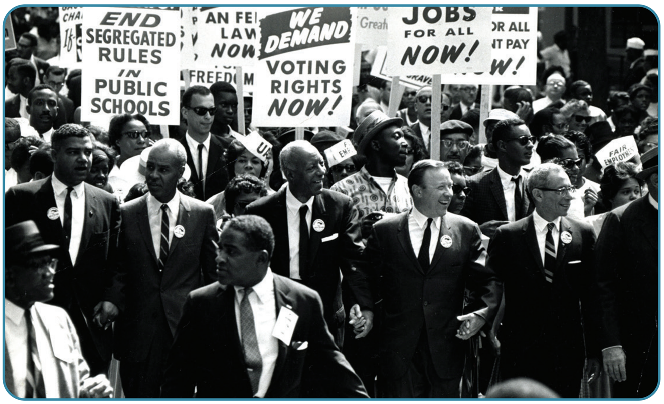
Strand Two & Three: The History of the World
Chapter Twenty-Eight: Life in the 1960s
Diagram taken from Artefact, 2nd Edition by Eimear Jenkinson and Gregg O'Neill (educate.ie)
@MsDoorley

Slide 44
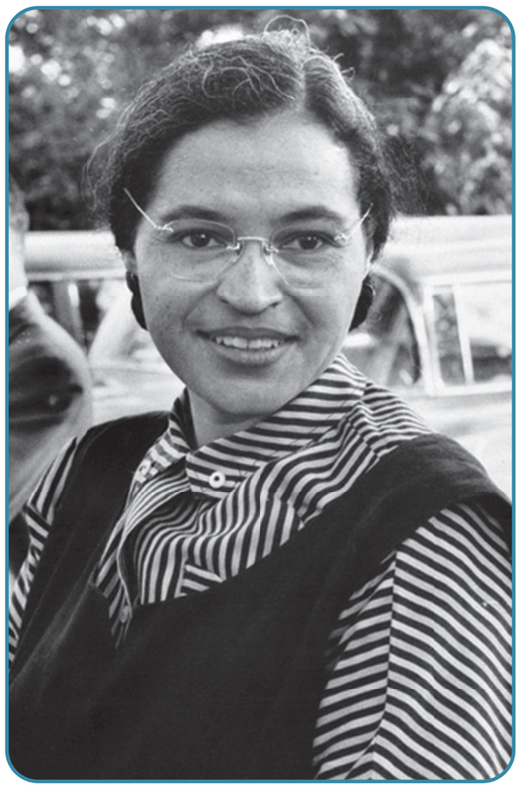
The Struggle for African American Rights
Some of the major events in the Civil Rights Movement were:
  1955: The Montgomery Bus Boycott, which saw the desegregation of public buses after a year-long boycott by black protesters. The boycott was sparked by the arrest of Rosa Parks, who had refused to surrender her seat to a white passenger.
  1957: In Little Rock, Arkansas, troops were sent in to protect nine black students who had enrolled in the all-white black school following the desegregation of schools.
  1960: Lunch counter protests saw hundreds of black students sit at ‘whites only’ restaurant counters and demand to be served.
  1963: 250,000 Americans of all races gathered in Washington to listen to Dr King deliver his famous ‘I have a dream’ speech where he outlined his vision for a racially equal America.
  1965: In Selma, Alabama, thousands marched for voting rights and were brutally attacked by the police.
  The Civil Rights Act (1964) and Voting Rights Act (1965) outlawed discrimination in the US in schools, the workplace and public services and guaranteed the right to vote for all US citizens.
Strand Two & Three: The History of the World
Chapter Twenty-Eight: Life in the 1960s
Diagram taken from Artefact, 2nd Edition by Eimear Jenkinson and Gregg O'Neill (educate.ie)
@MsDoorley

Slide 45
1960-1969
Chapter 28
DR MARTIN LUTHER KING JR, 1929-1968
Dr Martin Luther King Jr, 1929-1968
Strand Two & Three: The History of the World
@MsDoorley

Slide 46
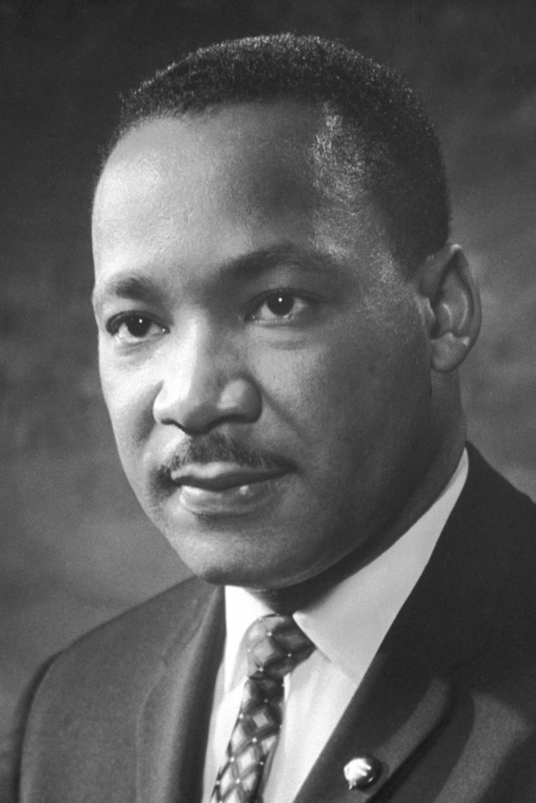
Montgomery
Dr Martin Luther King Jr was the single most important figure in the US Civil Rights Movement. King was born to a middle-class family in Atlanta, Georgia. He became a Baptist pastor in 1955 in Montgomery, Alabama. The local black population organised a boycott of the city's buses after Rosa Parks was arrested for refusing to give up her seat to a white man. King was appointed head of the Montgomery Improvement Association in early 1956 to lead the boycott. He championed non-violence and urged the African-American community to stand together by refusing to use the segregated buses. He was arrested by the police repeatedly, his family received threatening phone calls and his home was attacked. The boycott ended when the US Supreme Court ordered an end to segregation on buses.
Strand Two & Three: The History of the World
Chapter Twenty-Eight: Life in the 1960s
@MsDoorley

Slide 47
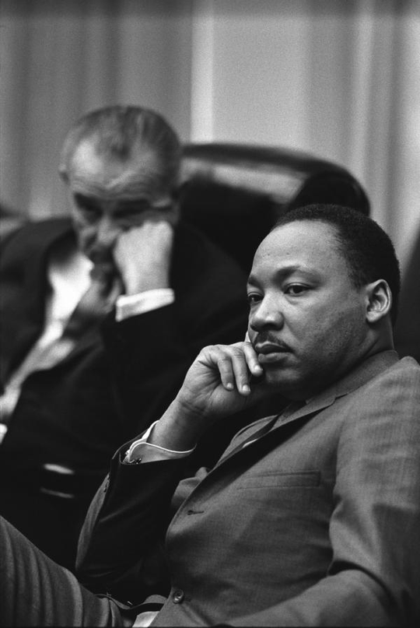
Civil rights leader
His success in Montgomery propelled him to a leadership role in the Civil Rights Movement. King knew how to cultivate massive media attention and his skills as an orator helped him to communicate his message through powerful speeches. His appeal reached beyond the black community to moderate white people and liberals. He had great influence over key political leaders such as Presidents Kennedy and Johnson, and unprecedented access to the White House. In 1957, King set up the Southern Christian Leadership Conference (SCLC), which aimed to use the methods from Montgomery (boycotts and non-violent tactics) and to continue working for change through the network of African-American churches across the South.
Strand Two & Three: The History of the World
Chapter Twenty-Eight: Life in the 1960s
@MsDoorley

Slide 48
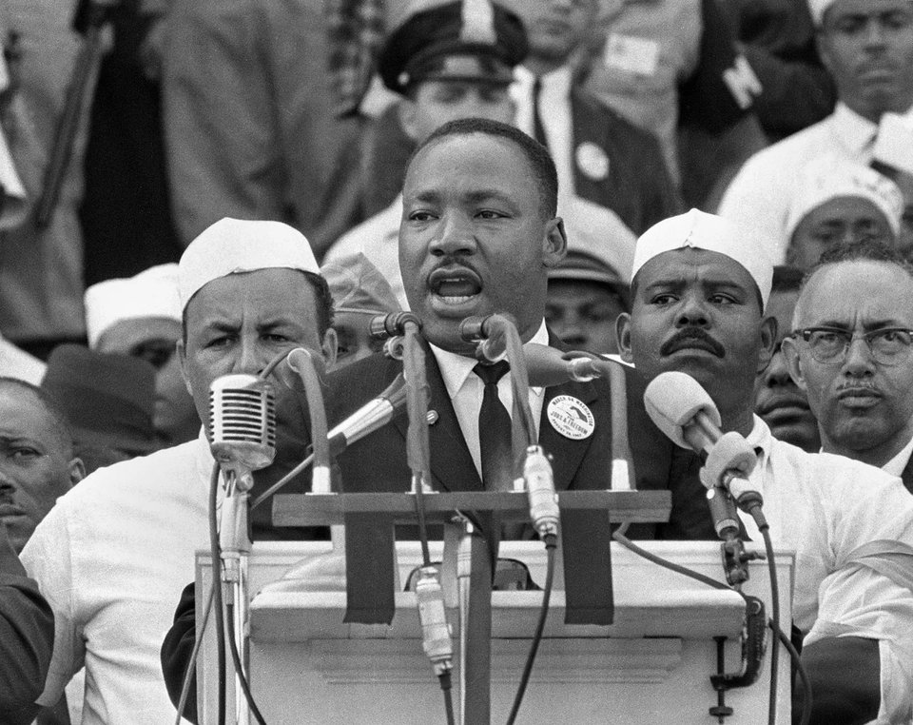
The Civil Rights Act
King's most famous moment was his 'I Have a Dream' speech at the March on Washington in 1963 in front of 250,000 people, with millions watching and listening around the world. His speech was eloquent and full of imagery, repetition and religious solidarity: 'All of God's children, black men and white men, Jews and Gentiles, Catholics and Protestants, will be able to join hands. I have a dream today...' The pressure created by the march contribute to the passing of the 1964 Civil Rights Act, which outlawed all forms of discrimination in the USA. In 1965, King turned his focus to voting rights, organising a five-day march from Selma to Montgomery. President Johnson introduced the Voting Rights Act 1965, which made illegal all barriers that had prevented African-Americans from voting. This was a high point for the Civil Rights Movement and for King himself. He won the Nobel Peace Prize in 1964 for his work for civil rights through peaceful means. After 1965, King moved his attention to economic inequality and opposition to the Vietnam War. In April 1968, King was assassinated by a white supremacist in Memphis, Tennessee.
Strand Two & Three: The History of the World
Chapter Twenty-Eight: Life in the 1960s
@MsDoorley

Slide 49
Other protest movements
The 1960s saw various groups take to the streets to challenge political leaders and demand changes in their respective societies. The Civil Rights Movement inspired many other protest movements around the world like that of the Northern Irish Catholics for equal rights before the Troubles in Northern Ireland and that of anti-war protests in the US during the Vietnam War. These movements very often did not achieve all of their aims in the 1960s. However, the goals of these groups became part of public debated, helping to change minds on these issues over time. And while some goals have still not been completed, there is little argument that there has been a lot of progress in the past 60 years.
  The women’s movement campaigned for equal treatment for women around the world (Ruth Bader Ginsburg and Betty Friedan).
  The African National Congress campaigned against the apartheid systems of racial discrimination in South Africa (Nelson Mandela and Desmond Tutu).
  The student movement campaigned for better conditions in universities and an end to inequality, war and poverty.
  The gay rights movement protested laws that treated LGBT people as criminals (Marsha P. Johnson and Dick Leitsch). A violent police raid on Stonewall Inn (a gay bar) in New York City in June 1969 sparked days of rioting. Within weeks, the LGBTQ+ community had began to organise and would quickly gather momentum.
  The environmental movement began to protest threats to the environment such as pollution, the use of chemicals in food and nuclear power.
Strand Two & Three: The History of the World
Chapter Twenty-Eight: Life in the 1960s
@MsDoorley

Slide 50
Other protest movements
•These movement all adopted similar tactics to try to achieve change:
  They organised marches to bring people out on the street; visibility highlighting the issues at stake and created media interest which, in turn, forced politicians to respond to the concerns being raised.
  They published magazines and books to raise awareness of their demands for change and keep people informed of developments in the campaign.
  They lobbied politicians to change laws.
Strand Two & Three: The History of the World
Chapter Twenty-Eight: Life in the 1960s
@MsDoorley

Slide 51
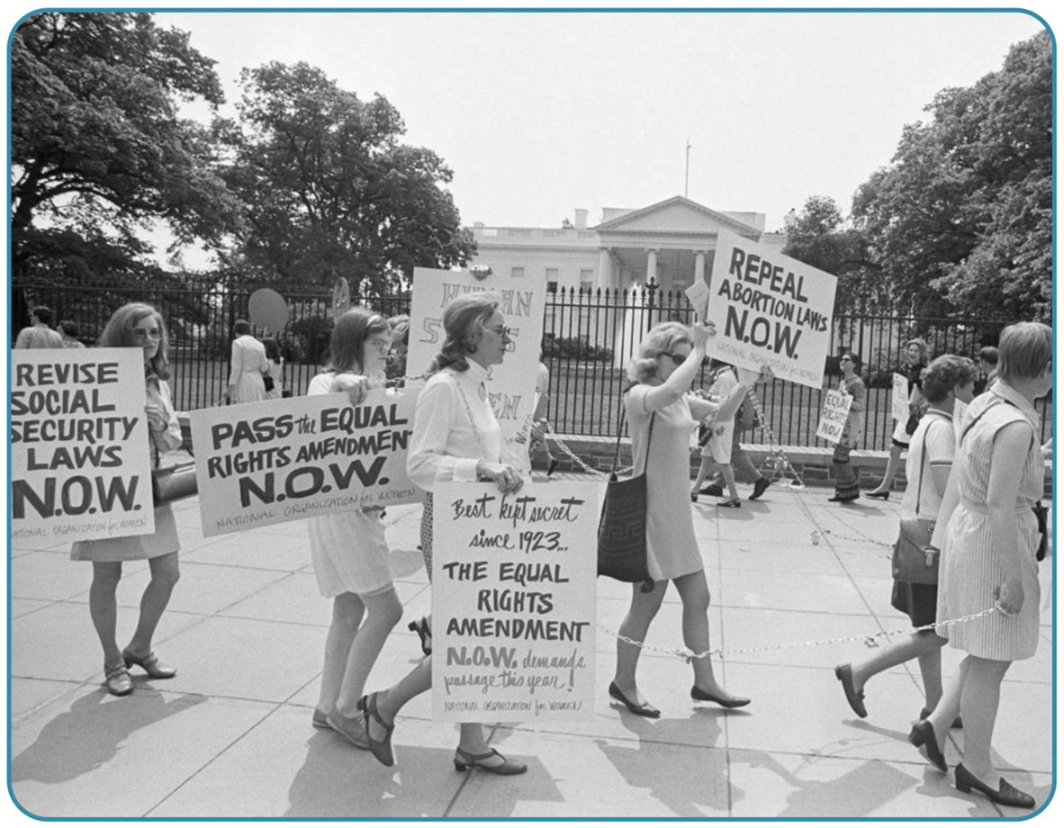
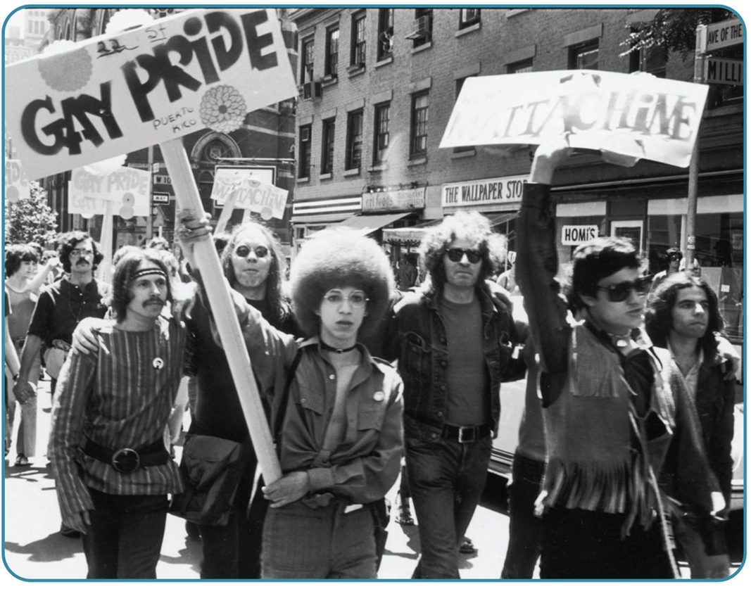
Strand Two & Three: The History of the World
Chapter Twenty-Eight: Life in the 1960s
Diagram taken from Artefact, 2nd Edition by Eimear Jenkinson and Gregg O'Neill (educate.ie)
@MsDoorley

Slide 52
Checkpoint pg. 381 (Artefact, 2nd Edition)
  How were African-Americans treated in the US before the Civil Rights Movement?
  What were the tactics used by the Civil Rights Movement?
  How did the African-American Civil Rights Movement inspire other movements around the world?
  Name one protest movement and its goals.
  How did these movements try to achieve change in their societies?
Strand Two & Three: The History of the World
Chapter Twenty-Eight: Life in the 1960s
@MsDoorley

Slide 53
Checkpoint pg. 381 (Artefact, 2nd Edition)
1. Before the Civil Rights Movement, African Americans were treated as second-class citizens. A century before that, many had been slaves. They were discriminated against in many states in education, housing, public facilities, employment, policing, the court system and voting.
2. The Civil Rights Movement used non-violent protest: protest marches and boycotts of businesses; using the media to highlight discrimination; and attacking discrimination laws in the courts.
3. The 1960s saw various groups take to the streets to challenge political leaders and demand change in their societies and they copied the tactics of the Civil Rights Movement.
4. Any of those listed on page 380 of the textbook is acceptable.
5. Most of the protest movements adopted similar tactics to those of the Civil Rights Movement. They organised marches to bring people out onto the streets. They published magazines and books to raise awareness of their demands for change and keep people informed of developments in the campaign. They lobbied politicians to change laws.
Strand Two & Three: The History of the World
Chapter Twenty-Eight: Life in the 1960s
@MsDoorley

Slide 54
1960-1969
Chapter 28
28.2.3: YOUTH CULTURE
28.2.3: youth culture
Strand Two & Three: The History of the World
@MsDoorley

Slide 55
The emergence of youth culture
After World War II, there was a ‘baby boom’ in the West as soldiers returned home, married and had large families; by the 1960s, these children were reaching their teenage years (these babies would be in ranging between 57-75 years old now). Thanks to free education in many countries, these young people were better educated than in previous generations. The economies of most Western countries boomed in the 1950s and 1960s so people had a lot more money to spend than their parents had at the same age.
Young people developed their own tastes in music, fashion and entertainment (youth culture). Very often, it seemed they favoured things that seemed to reject the values of their parents’ generation. They expressed their difference from what came through their music and dress.
Strand Two & Three: The History of the World
Chapter Twenty-Eight: Life in the 1960s
@MsDoorley

Slide 56
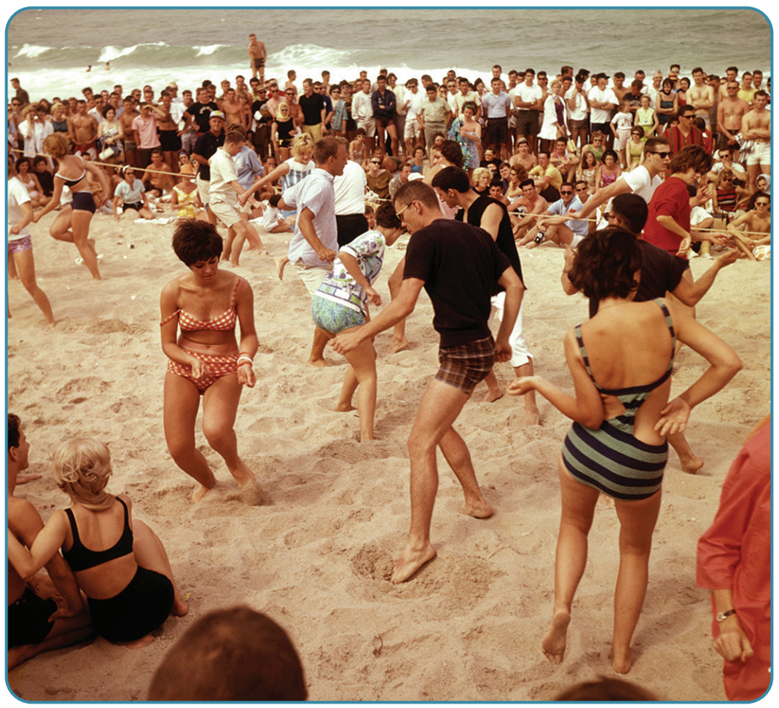
Strand Two & Three: The History of the World
Chapter Twenty-Eight: Life in the 1960s
Diagram taken from Artefact, 2nd Edition by Eimear Jenkinson and Gregg O'Neill (educate.ie)
@MsDoorley

Slide 57
Music
For the first time, musicians produced music that was deliberately aimed at young people. Pop stars recorded music that was bought in huge quantities by teenagers. This new ‘pop music’ sounded different and addressed topics that made adults uncomfortable: love, sex, drugs and personal freedom. Many musicians also wrote about the difficult issues of the day in their music. Many older people criticised this music for encouraging what they thought was socially unacceptable behaviour but this endeared it to teenagers even more. Some very popular 1960s music acts were:
Strand Two & Three: The History of the World
Chapter Twenty-Eight: Life in the 1960s
  The Beatles
  The Rolling Stones
  Bob Dylan
  The Doors
  Dusty Springfield
  The Supremes
  Elvis Presly
  Aretha Franklin
  Janis Joplin
  Jimi Hendrix
@MsDoorley

Slide 58
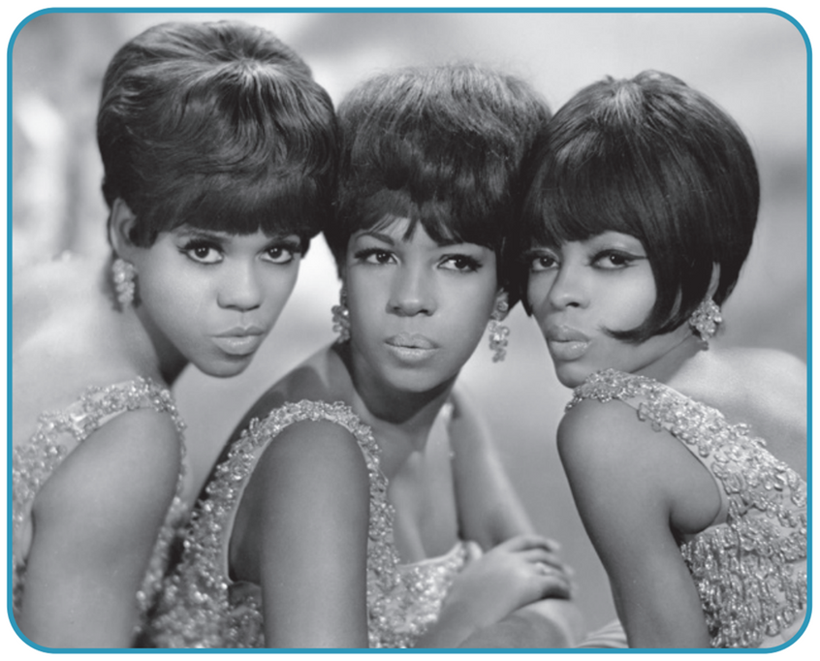
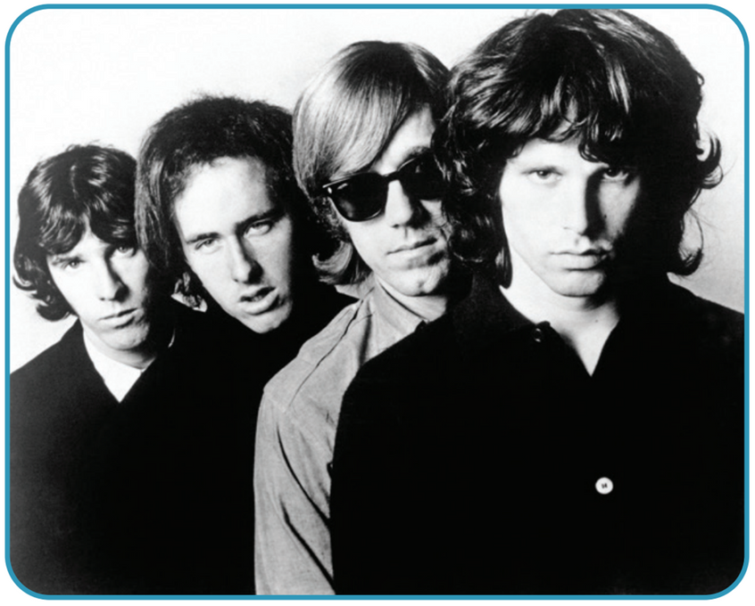
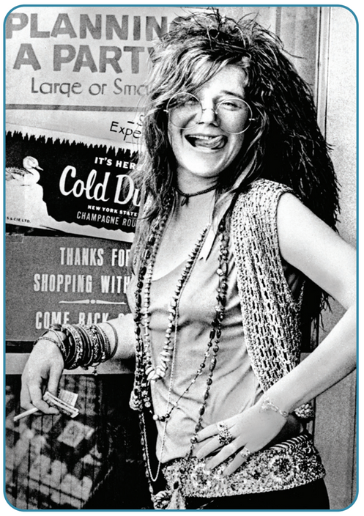
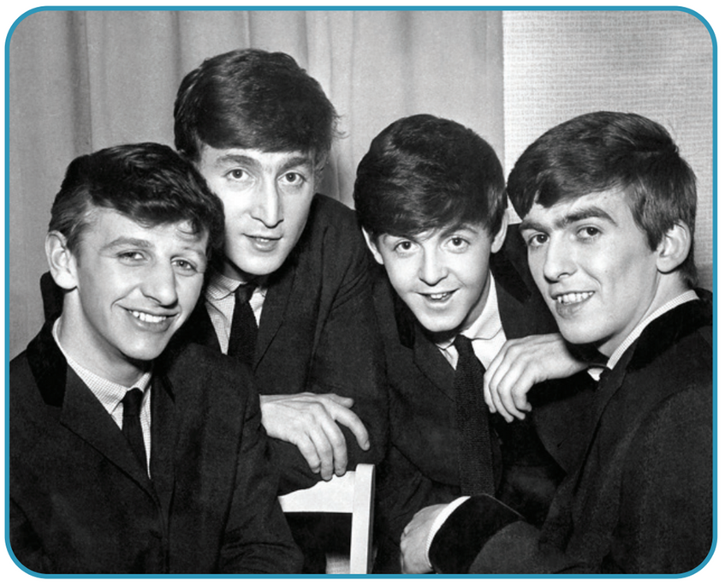
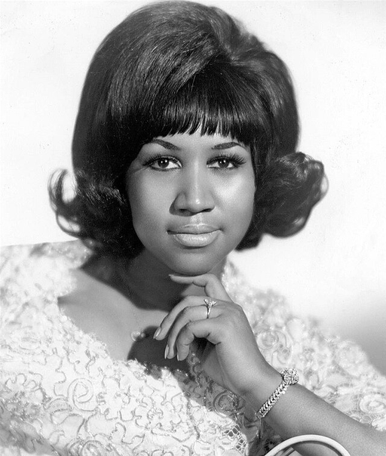
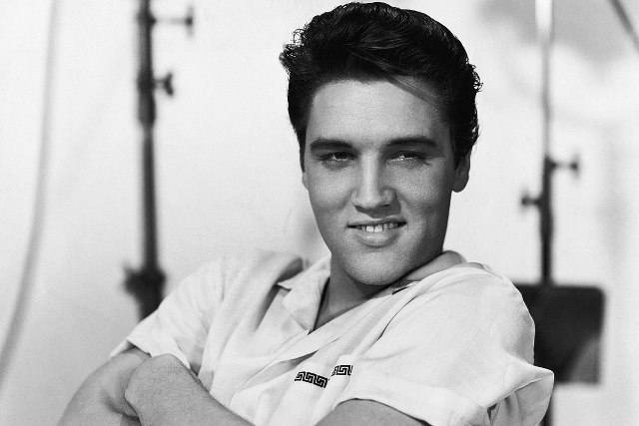
Strand Two & Three: The History of the World
Chapter Twenty-Eight: Life in the 1960s
Diagram taken from Artefact, 2nd Edition by Eimear Jenkinson and Gregg O'Neill (educate.ie)
@MsDoorley

Slide 59
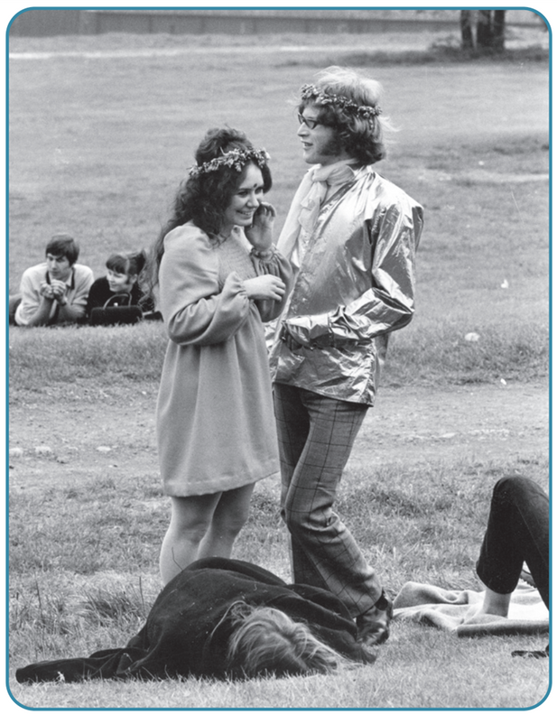
Fashion
The clothes that young people wore in the 1960s also reflected new values. By the mid-1960s, the more conservative styles of the 1950s had been replaced with bright, swirling colours and very different styles. Gone were the below-the-knee-length skirts for women and in came the miniskirt. Psychedelic, tie-dye shirts, long hair and beards replaced the traditional short hair, shirts and trousers on men. These new fashions symbolised the rejection of values of their parents and many of these new trends, especially for those women, scandalised older people.
A key aim of the women’s movement in the 1960s was to give women a greater control over their own personal lives and relationships. The miniskirt came to symbolise the new sexual freedom that women now enjoyed thanks to the availability of the contraceptive pill.
Strand Two & Three: The History of the World
Chapter Twenty-Eight: Life in the 1960s
Diagram taken from Artefact, 2nd Edition by Eimear Jenkinson and Gregg O'Neill (educate.ie)
@MsDoorley

Slide 60
The impact of youth culture
  Free education meant that more young people went to university and were better educated than before.
  They wanted a different world to that of their parents. This demand was expressed in many ways, including the student movement, new musical styles and new attitudes to clothes.
  Behaviour changed as well. Many young people, especially young women, began to question their expected place in society and to demand more freedom and choice.
  As the economies of the West grew, more young people had their own jobs, including large numbers of women. This meant they had greater economic independence from their parents.
  By the end of the 1960s, they were marrying and children at a later age. Marriage breakdown became more accepted and divorce more common.
Strand Two & Three: The History of the World
Chapter Twenty-Eight: Life in the 1960s
@MsDoorley

Slide 61
Checkpoint pg. 383 (Artefact, 2nd Edition)
  How were young people of the 1960s different from their parents’ generation?
  What was youth culture?
  How did music change during the 1960s?
  Why was the music of the 1960s criticised by some people?
  How did fashion change during the 1960s? What did these changes represent?
  How did the lives of young people change during the 1960s?
Strand Two & Three: The History of the World
Chapter Twenty-Eight: Life in the 1960s
@MsDoorley

Slide 62
Checkpoint pg. 383 (Artefact, 2nd Edition)
1. Young people of the 1960s were better educated than previous generations due to free education and had far more money to spend than their parents had at the same age.
2. Youth culture: young people’s tastes in music, fashion and entertainment.
3. It sounded very different and addressed topics such as love, sex, drugs, personal freedom and politics.
4. They believed it encouraged socially unacceptable behaviour among young people.
5. 1960s fashion featured bright, swirling colours and very different, playful styles. The miniskirt arrived for women. For men, psychedelic tie-dye shirts, long hair and beards replaced the traditional, conservative short hair, shirts and trousers. These new fashions symbolised the rejection of their parents’ values.
6. They were better educated, wealthier and had more freedom than the generations who went before them.
Strand Two & Three: The History of the World
Chapter Twenty-Eight: Life in the 1960s
@MsDoorley

Slide 63
1960-1969
Chapter 28
28.3: SUMMARY
28.3: summary
Strand Two & Three: The History of the World
@MsDoorley

Slide 64
In this chapter, we have learned that...
  Like the rest of the world, Ireland experienced rapid and far-reaching changes during the 1960s. Nearly all the changes were initiated by governments led by Seán Lemass. In some cases, like the economy, the impact was immediate. In other cases, like the launch of RTÉ or Vatican II, the effect would take longer to be felt in society.
  Economics: Ireland dropped protectionism in favour of free trade and foreign investment.
  Northern Ireland: Lemass met with Terence O’Neill to forge better relations on the island.
  Internationally: Ireland become more active in the UN, applied for EEC membership and welcomed US President Kennedy on a state visit.
  Politics: a new generation of leaders took over the running of the state.
  RTÉ: Irish television meant that people were exposed to more outside influences, debates about controversial topics and the questioning of those in positions of power.
  Vatican II: the Catholic Church introduced changes to its practices and teaching.
  Education: free schooling meant that more children than ever before finished secondary school.
Strand Two & Three: The History of the World
Chapter Twenty-Eight: Life in the 1960s
@MsDoorley

Slide 65
In this chapter, we have learned that...
  The 1960s were a period of dramatic change in the world. As we have seen, this decade marked the height of the Cold War. In Europe, more countries applied to join the European Economic Community, as it helped to create economic prosperity.
  The space race between the US and the USSR peaked in 1969, when the US put a man on the moon.
  African-Americans continued their campaign for civil rights in the US and achieved the passing of major new laws protecting equal rights and banning discrimination.
  Their success inspired many other oppressed and marginalised groups (such as women and LGBT people) and other campaigns (for example, students and environmentalists) worldwide.
  Young people emerged as an important force in society and their new ‘youth culture’ was expressed through music, fashion and social changes.
Strand Two & Three: The History of the World
Chapter Twenty-Eight: Life in the 1960s
@MsDoorley

Slide 66
Reflecting on... Life in the 1960s
It would be wrong to see Ireland as being a completely different place by the end of the 1960s. Social change came gradually in the years and decades that followed. But the impact of RTÉ, Vatican II, economic change, international openness and access to education would be felt for decades to come. That is why many historians consider the 1960s to make the birth of modern Ireland.
The change of the 1960s shaped the world we live in today in profound ways. The advances needed to land a human being on the moon symbolised the huge leaps in technology and communications that have since transformed the modern world. On another level, the common theme running through much of the social conflict and change was that of freedom for individuals from oppressive attitudes such as racism, sexism and homophobia. These issues were certainly not resolved in the 1960s and our world continues to struggle with them today.
Strand Two & Three: The History of the World
Chapter Twenty-Eight: Life in the 1960s
@MsDoorley

Slide 67
SEC Examination Questions
2021 SEC Sample Q9
2022 SEC Q8 (e-g)
Strand Two & Three: The History of the World
Chapter Twenty-Eight: Life in the 1960s
@MsDoorley

Slide 68
Project
Guidelines:
  Length: The depth of your project should reflect about 2-3 weeks of work.
  Sources: Use at least three different sources for your research. These can be books, scholarly articles, or reputable online resources.
  Citations: All information and images that are not your own should be properly cited.
  Mediums: You may choose to present your project in one of the following ways:
    Poster: Your poster should be informative and visually engaging.
    Minecraft or Lego Model: If choosing this option, please also include a brief report explaining your model.
    Painting/Drawing: Your artwork should be accompanied by a description.
    Recycled Materials: Create your model using recycled materials and provide an explanation of your creative process.
Assessment:
Your projects will be assessed based on:
  Research and Content
  Creativity and Presentation
  Understanding of Context
  Adherence to Guidelines
Strand Two: The History of Ireland
Chapter Twenty-Eight: Ireland in the 1960s
@MsDoorley

Slide 69
Project
Historical Sites
Historical Figures
RTE Television Studios, Dublin, Republic of Ireland
O'Connell Street, Dublin, Republic of Ireland
University College Dublin, Belfield Campus
Nelson's Pillar Site, Dublin, Republic of Ireland
Aras an Uachtarain, Dublin, Republic of Ireland
Seán Lemass
T.K Whitaker
Archbishop McQuaid
Declan Costello
Cardinal Conway
Gay Byrne
Michael O’Hehir
Feargal Quinn
Mick O’Connell
Edna O’Brien
Frances Condell
Monica Sheridan
Seán Ó Riada
Bridie Gallagher
Maureen Potter
Strand Two: The History of Ireland
Chapter Twenty-Eight: Ireland in the 1960s
@MsDoorley

Slide 70
Project
Historical Sites
Historical Figures
Martin Luther King Jr. National Historical Park, Atlanta, Georgia
Woodstock Site, Bethel, New York
The Apollo Theater, Harlem, New York
Haight-Ashbury District, San Francisco, California
National Mall, Washington, D.C.
President John F. Kennedy
Martin Luther King
President Lyndon Johnson
Mao Zedong
Elvis Presley
John Lennon
Paul McCartney
Mick Jagger
John Glenn
Neil Armstrong
Wernher von Braun
Yuri Gagarin
Valentina Tereshkova
Ho Chi Minh
Muhammad Ali
Pope John XXIII
Betty Friedan
Strand Three: The History of Europe and the Wider World
Chapter Twenty-Eight: The US in the 1960s
@MsDoorley

